Slide 1
SQL PROJECT STRUCTURED QUERY LANGUAGE
Under Guidance: Presented By
Mr.Kavi Bharathi Sujani Khan
(Besant Tech)

Slide 2

SQL stands for Structured Query Language. It is a language used to communicate, manage or manipulate in a relational database management system (RDBMS). A relational database stores information in tabular form.

Slide 3

SQL commands are mainly categorized into five categories:
DDL: Data Definition Language
DQL: Data Query Language
DML: Data Manipulation Language
DCL: Data Control Language
TCL: Transaction Control Language

Slide 4
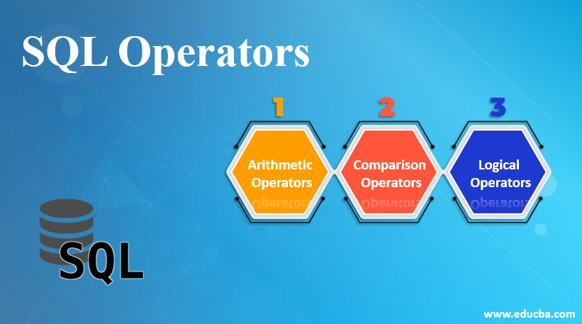
Operators in SQL
An operator is a reserved word or character that is used to query our database in a SQL expression. To query a database using operators, we use WHERE clause.
Types of operators:
1.Arithmetic Operator
2.Concatenation Operator
3.Comparison Operator
4.Relational Operator
5.Logical Operator
6.Special Operator
7.Sub Query Operator

Slide 5
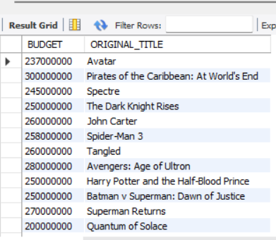
WAQTD budget and original_title of the movies where budget is greater than 30000000.
SELECT BUDGET, ORIGINAL_TITLE
FROM tmdb_5000_movies
WHERE BUDGET>30000000;

Slide 6
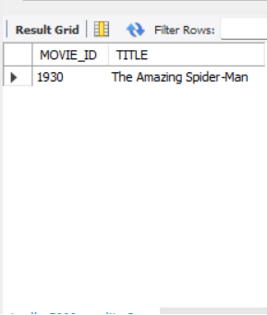
WAQTD name of the movies whose movie_id is 1930.
SELECT MOVIE_ID, TITLE
FROM tmdb_5000_credits
WHERE MOVIE_ID=1930;

Slide 7
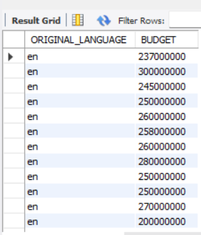
WAQTD movies that are in English language or budget is greater than 50000000.
SELECT ORIGINAL_LANGUAGE, BUDGET
FROM tmdb_5000_movies
WHERE ORIGINAL_LANGUAGE=‘EN’ OR BUDGET>50000000;

Slide 8
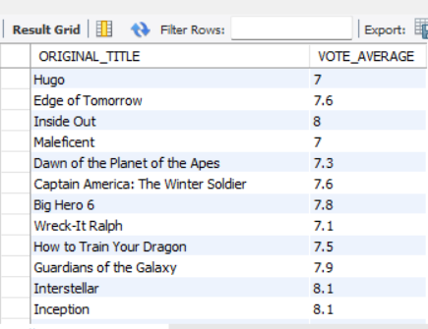
WAQTD original_title and vote_average whose vote_average between 7 and 9.
SELECT ORIGINAL_TITLE, VOTE_AVERAGE
FROM tmdb_5000_movies
WHERE VOTE_AVERAGE BETWEEN 7 AND 9;

Slide 9
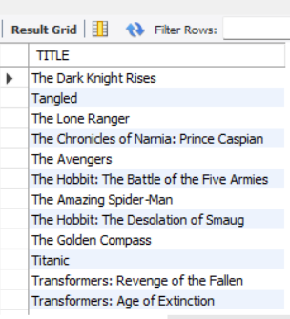
WAQTD name of the movies starting with T.
SELECT TITLE
FROM tmdb_5000_credits
Where title like ‘T’;

Slide 10
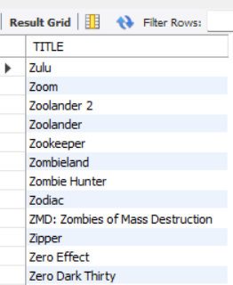
WAQTD name of the movies in descending order.
SELECT TITLE
FROM tmdb_5000_credits
ORDER BY TITLE DESC;

Slide 11
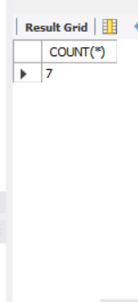
WAQTD number of movies having vote_count greater than 9106.
SELECT COUNT(*)
FROM tmdb_5000_movies
WHERE VOTE_COUNT>9106;

Slide 12
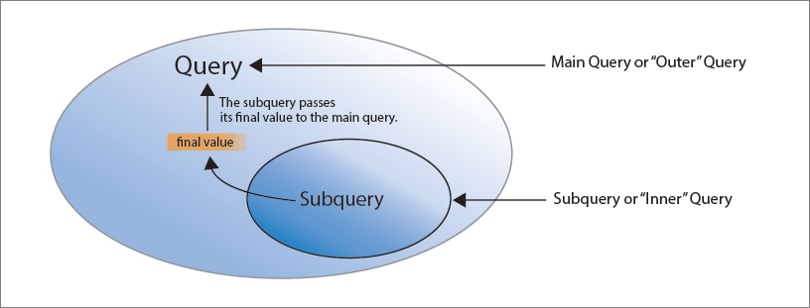
Sub Query in SQL
A query written inside another query is called sub query. In sub query the inner query will execute first and produce output. The output of inner query will be passed as a input to the outer query and then the outer query will produce the complete result. Therefore the outer query and inner query completely depends on each other
There are two cases of sub query
Case1:When we have unknown present in the query we go for sub query
Case2:Whenever the data to be selected and the condition are present in a different tables

Slide 13
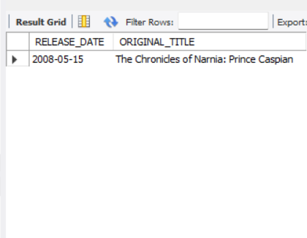
WAQTD release date and original_title whose id is 2454.
SELECT RELEASE_DATE,ORIGINAL_TITLE
FROM tmdb_5000_movies
WHERE TITLE IN
(SELECT TITLE
FROM tmdb_5000_credits
WHERE MOVIE_ID=2454);

Slide 14
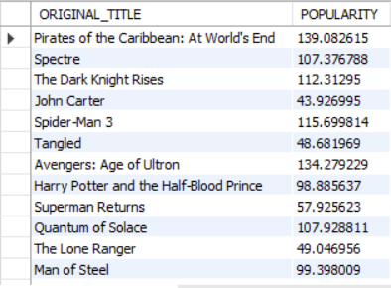
WAQTD name of the movies and popularity whose popularity is less than The Avengers.
SELECT ORIGINAL_TITLE,POPULARITY
FROM tmdb_5000_movies
WHERE POPULARITY<
(SELECT POPULARITY
FROM tmdb_5000_movies
WHERE ORIGINAL_TITLE=‘THE AVENGERS’);

Slide 15
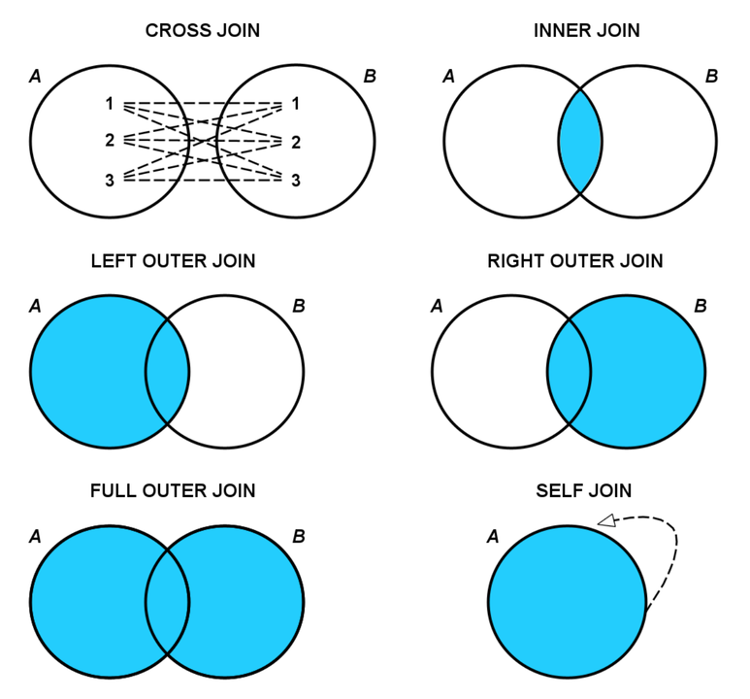
Joins
It is a process of retrieve or fetch data from multiple table simultaneously. There are five types of join
1.Cartesian Join or Cross Join
2.Inner Join
3.Outer Join (Left Outer, Right Outer and Full Outer)
4.Natural Join
5.Self join

Slide 16
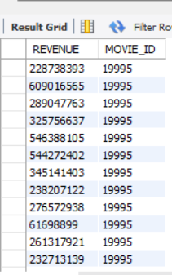
WAQTD revenue and movie_id using cross join.
SELECT REVENUE, MOVIE_ID
FROM tmdb_5000_movies CROSS JOIN tmdb_5000_credits;

Slide 17
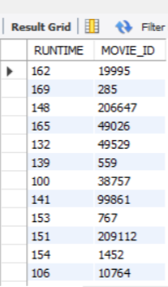
WAQTD runtime and movie_id using inner join.
SELECT RUNTIME, MOVIE_ID
FROM tmdb_5000_movies INNER JOIN tmdb_5000_credits
ON tmdb_5000_movies.TITLE=tmdb_5000_credits.TITLE;

Slide 18
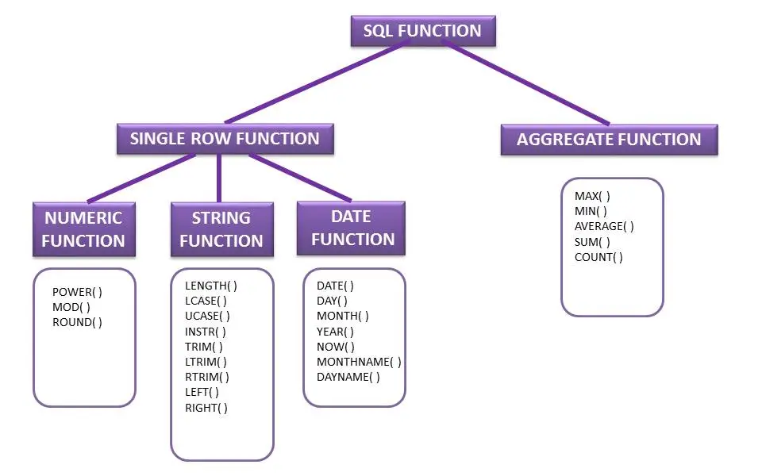
Functions
Functions are block of code or list of instruction which will do some specific task.There are two types of functions namely User Defined Function and Buildin Function (Aggregate Function). Buildin Function are of two types :
1.Single Row Function
2.Multi Row Function

Slide 19
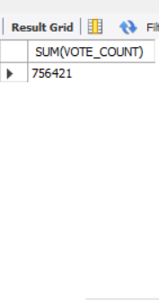
WAQTD total vote_count.
SELECT SUM(VOTE_COUNT)
FROM tmdb_5000_movies;

Slide 20
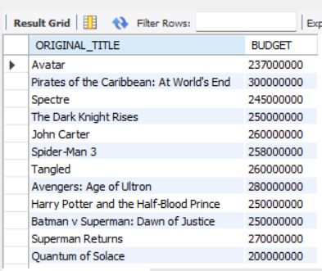
WAQTD name of the movies whose budget is exactly nine digits.
SELECT ORIGINAL_TITLE,BUDGET
FROM tmdb_5000_movies
WHERE BUDGET LIKE’_________’;

Slide 21
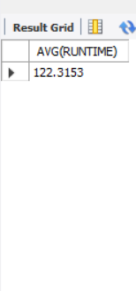
WAQTD average runtime.
SELECT AVG(RUNTIME)
FROM tmdb_5000_movies;

Slide 22
THANK YOU

